Slide 1

A Pareto Framework for Data Analytics on Heterogeneous Systems:
Implications for Green Energy Usage and Performance
Aniket Chakrabarti, Srinivasan Parthasarathy, and Christopher Stewart

Slide 2

Analytics is Big Business
Big data and business analytics industry will surpass $200 billion in 2020. [IDC report]
Revenue growth from information-based products will double the rest of the product/service portfolio for one third of Fortune 500 companies. [IDC report]
“There’s gold in them there mountains of data”
- Gill Press, Forbes Contributor

Slide 3
The Data Deluge
Around 10 zettabytes data created in 2015 [IDC report]
180 zettabytes will be created in 2025 [IDC report]
It is paramount to analyse large, diverse volumes of data, extract useful business insights that inform timely decisions

Slide 4
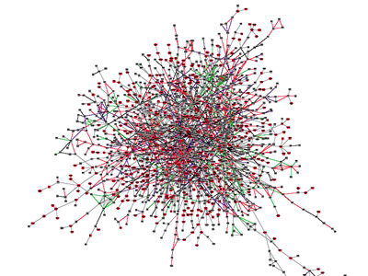
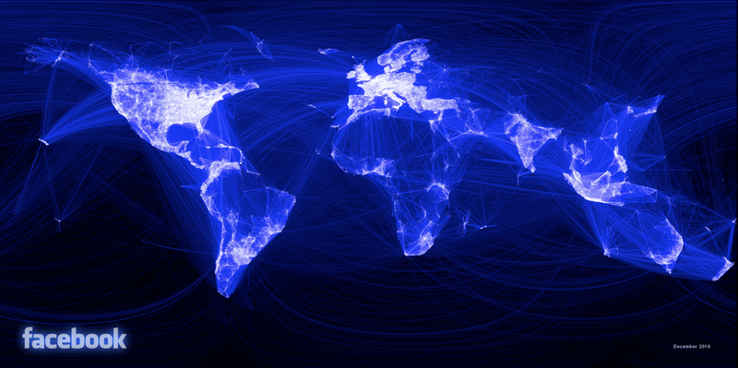

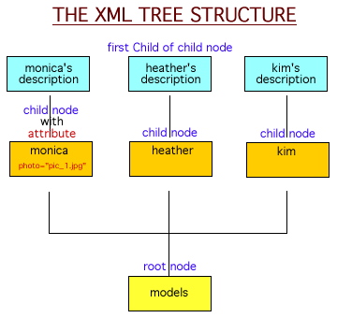
Some Examples
Graph Mining
Medical/Scientific Data
Text Mining
Compression

Slide 5
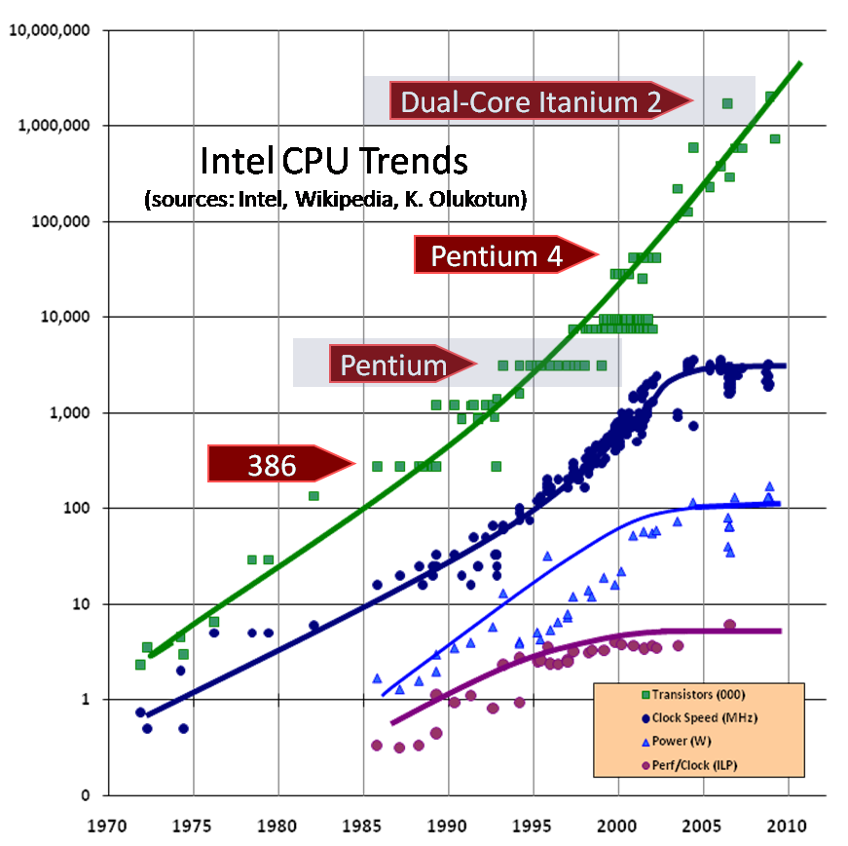
Data Deluge Outpaces Processing Rate

Slide 6
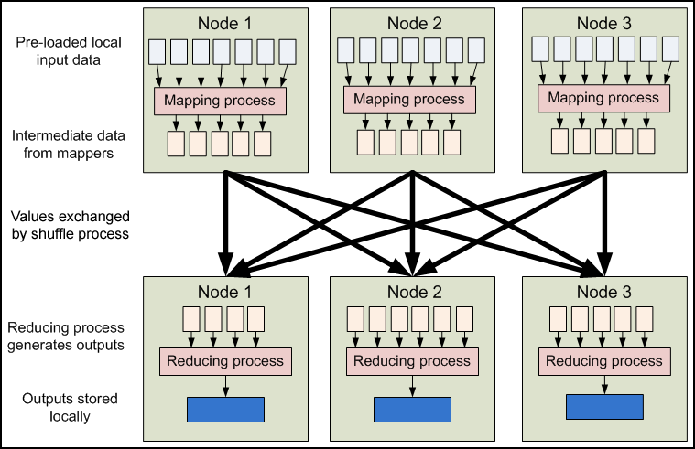
Solution: Distributed Computing
MapReduce, MPI, Spark, etc.
Source: blog.mayflower.de

Slide 7
Challenges for Distributed Analytics
Heterogeneity
  Compute clusters are heterogeneous
  Workload imbalance across partitions
  Imbalance in execution time and energy consumption
Data skew (Data mining workloads)
  Skew in statistical distribution of data across partitions
  May lead to load imbalance

Slide 8
Example – Image retrieval
Random partitioning
Load imbalance
Stratified partitioning
Load imbalance mitigated

Slide 9
Our Solution
Framework to manage data partitions
  Should be content aware
    Mitigate skew
  Should be sized according to capacity
    Load balanced

Slide 10
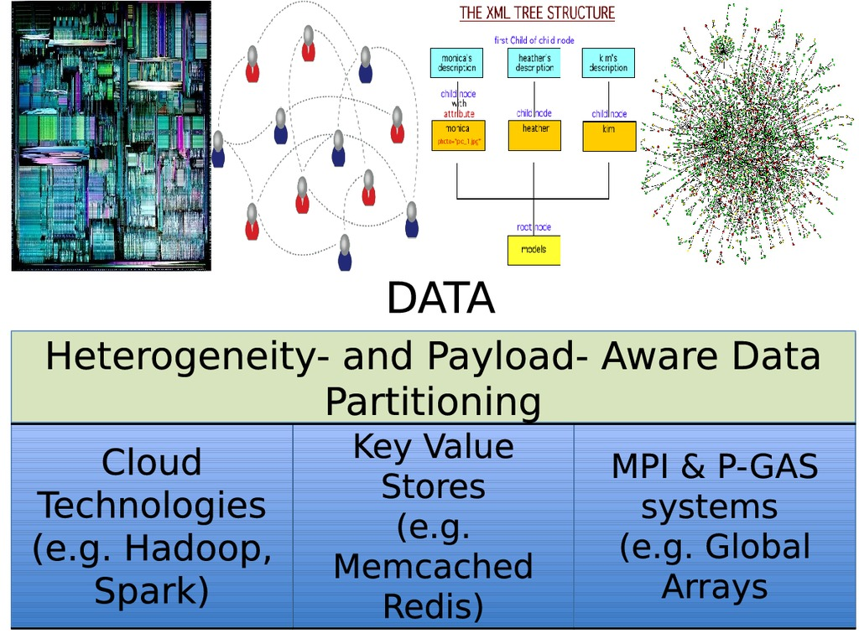
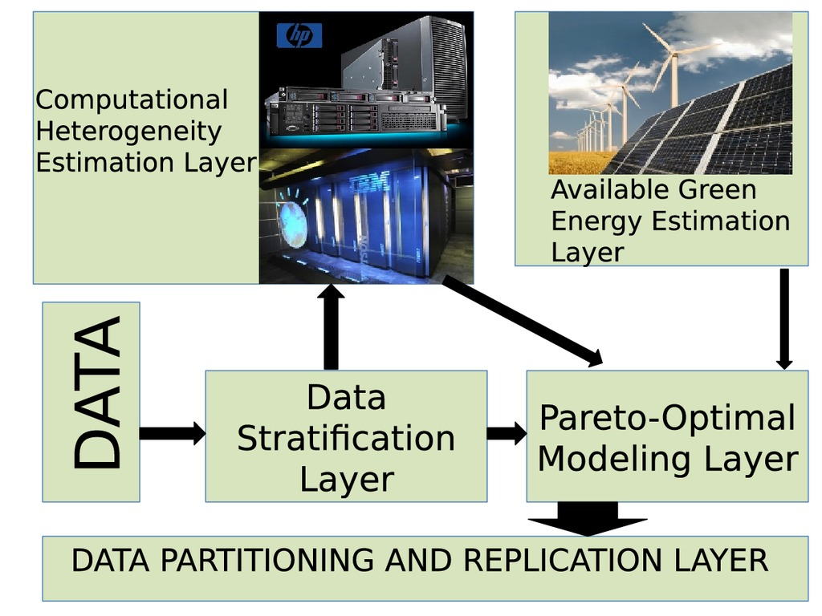
Proposed Framework

Slide 11




Computational Heterogeneity Estimation Layer
$$f_{i}\left(x_{i}\right)=m_{i}x_{i}+c_{i}$$
$$f_{i}\left(x_{i}\right)$$
$$m_{i},c_{i}$$
$$x_{i}$$
Goal: Given input size, predict the execution time of a specific algorithm on a specific machine
Simple linear model
For node i:
  Predicted execution time:
  Regression coefficients:
  Input partition size:

Slide 12
Use progressive sampling
  On each machine, collect execution times on small samples of increasing size
Samples should reflect distribution of final partitions
Use optimal stratified sampling [Cochran ‘46]
In-memory stratification technique [Tatikonda, ICDE 2010]
  For each data object, extract local pivot signatures
  Define locality sensitive hash functions using pivots
  Cluster similar objects
  Output: Object(i) → Type(j)

Slide 13
Proposed Framework

Slide 14





Available Green Energy Estimation Layer
Use [Goiri '11] to model availability of renewable energy
  Available energy at hour t:
  Cloud cover at t:
  Attenuation factor:
  Availability under ideal conditions at t:
$$\text{GE}\left(t\right)=p\left(w\left(t\right)\right)B\left(t\right)$$
$$\text{GE}\left(t\right)$$
$$w\left(t\right)$$
$$p\left(x\right)$$
$$B\left(t\right)$$

Slide 15
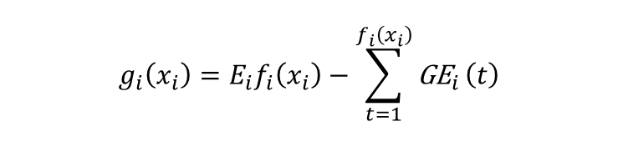


For node i, the dirty energy consumption for a job is modeled as
  Predicted dirty energy:
  Avg. total energy consumed per hour:
$$g_{i}\left(x_{i}\right)=E_{i}f_{i}\left(x_{i}\right)−\sum_{t=1}^{f_{i}\left(x_{i}\right)}{{\text{GE}}_{i}}\left(t\right)$$
$$g_{i}\left(x_{i}\right)$$
$$E_{i}$$

Slide 16
Proposed Framework

Slide 17

Pareto Optimal Modeling Layer
$$\underset{x_{i}}{minimize}\left\{max\left(f_{i}\left(x_{i}\right)\right),\sum_{i=1}^{p}{g_{i}}\left(x_{i}\right)\right\}$$
$$\begin{matrix} \\ s.t.\sum_{i=1}^{p}{x_{i}}=N\end{matrix}$$
Goal: Find partition size distribution that will (1) minimize the maximum execution time across partitions and (2) minimize the total dirty energy footprint

Slide 18


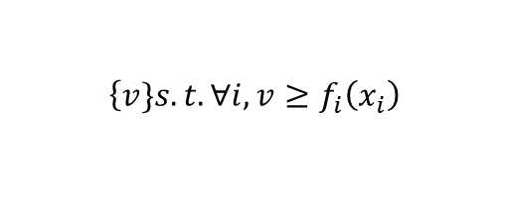
Linear Programming Formulation
$$max\left(f_{i}\left(x_{i}\right)\right)$$
$$\left\{v\}s.t.∀i,v≥f_{i}\left(x_{i}\right)\right.$$
$$\begin{matrix}minimize\left(αv+\left(1−α\right)\sum_{i=1}^{p}{g_{i}}\left(x_{i}\right)\right) \\ s.t. \\ ∀i,v≥f_{i}\left(x_{i}\right) \\ \sum_{i=i}^{p}{x_{i}}=N\end{matrix}$$
can be replaced by
After applying scalarization
Can be efficiently solved

Slide 19
Data Partitioning and Replication Layer
Support two strategies
  Proportional Allocation
    Each partition has data from each strata, proportional to the strata size
    Guarantees similar statistical properties across partitions
  All-in-one
    Places similar data items in a partition
    Sort using strata and partition

Slide 20
Evaluation – Setup
  OSC Oakley cluster; 32 servers
  Type 1: 2.2 GHz processor, 48GB RAM
  Type 2: 1.1 GHz processor
  Type 3: 600 MHz processor
  Type 4: 300 MHz processor
  Green energy availability based on 4 Google data center locations
  Green/Dirty mix is independent of speed

Slide 21
Evaluation – Datasets and Applications
Dataset | Application
RCV (Text) | Apriori (Frequent Text Mining)
Swiss Protein (Tree) | LCSTRIPS (Frequent Tree Mining)
Treebank (Tree) | LCSTRIPS (Frequent Tree Mining)
UK (Graph) | LZ77, Webgraph (Compression)
Arabic (Graph) | LZ77, Webgraph (Compression)

Slide 22
Evaluation – Frequent Text Mining
RCV

Slide 23
Evaluation – Webgraph Compression
UK

Slide 24
Evaluation – Pareto Frontiers
Swiss
RCV
UK

Slide 25
Conclusions
Our framework enables capacity & payload aware analytics
  Used LSH for efficient payload awareness
  Used a Pareto Framework for capacity awareness
Improves performance for distributed analytics from text mining to frequent tree mining to compression
Supported by NSF grants: IIS-1550302, CCF-1629548, CNS-1350941, CSR-1320071 and CNS-1513120.

Slide 26
Future Work
Linear assumption of our framework may be simplistic
  Explore non-linear models
  Alternatively, use multiple shards within a partition
    Execution time will be linear in the number of shards
Combine static partitioning with dynamic load balancing techniques such as work stealing
  Helps adapt to sudden changes in the computing environment

