Slide 1
Procedural Content Lab1
CSE 788
Prof. Roger Crawfis

Slide 2
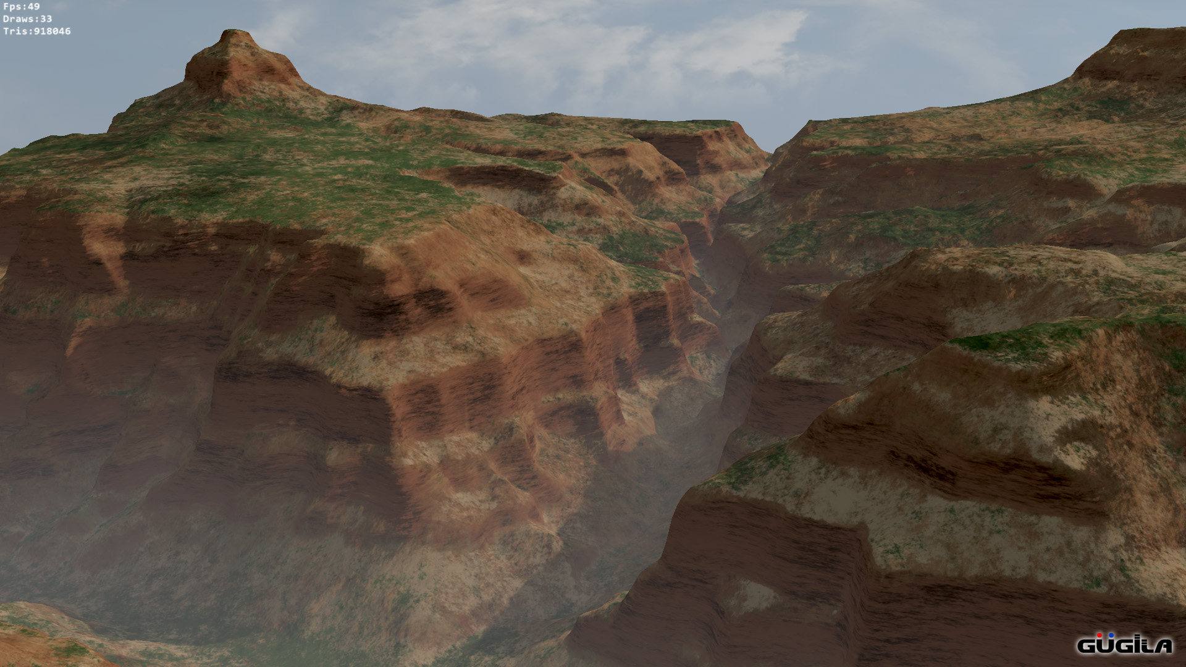
Canyon walk-thru

Slide 3
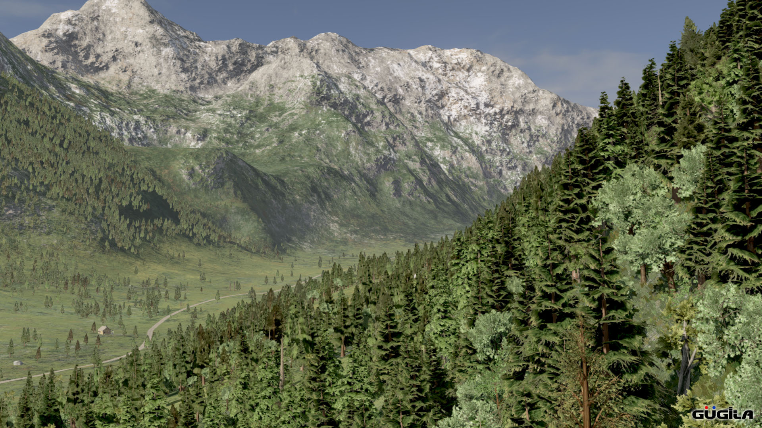

Slide 4
Making a 1D Valley
Add a flat floor.
Carve out two parabolas:
Debris
Wall
Offset parabolas.
Take the max of all.
Add noise or fractal.
Take min with mountains.

Slide 5
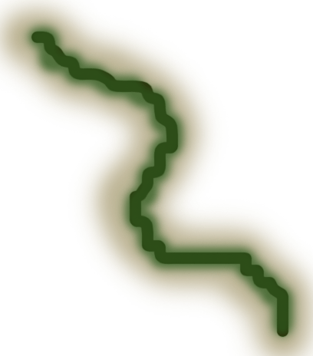
Making a Canyon
For a canyon, the valley profile cure needs to be swept through some space.
Start with a line or curve:
Subdivide it and displace.
Orient valley perpendicular to the curve.
Adjust parameters as the curve is swept.
Not shown here.
start
end

Slide 6
Making a Canyon
Create a color map
Based on height
Based on slope
Based on classification
Adds some randomness

Slide 7
Extra Credit
Add a river or a road
Easiest would be to add a lower portion to the valley curve.
Color the bottom and add a flat water plane.
Add a Sky layer, sky box, etc.
Render it in 3D using whatever:
http://picogen.org/
…

Slide 8
What to turn in
Images of the height, color, roughness.
You do not need to render it in 3D.
Description on how you generated.
3-4 Powerpoint slides that visual guide the class through your creation.

